Slide 1

DATA ANALYST INTERNSHIP
HR DATA ANALYSIS ASSESSMENT
By,
Prajna I G Bhat

Slide 2
Introduction
HR data analysis plays a vital role in optimizing workforce management, boosting employee engagement, and refining recruitment strategies. By leveraging data-driven insights, it helps organizations identify trends, address issues, forecast future workforce needs, and ensure regulatory compliance, all of which contribute to improved organizational efficiency and success.
The dataset includes information on over 4,000 employees from a large company, covering aspects such as age, gender, education, department, salary, performance ratings, promotion status, and attrition rates.
The analysis is conducted using tools like Excel and Power BI.

Slide 3
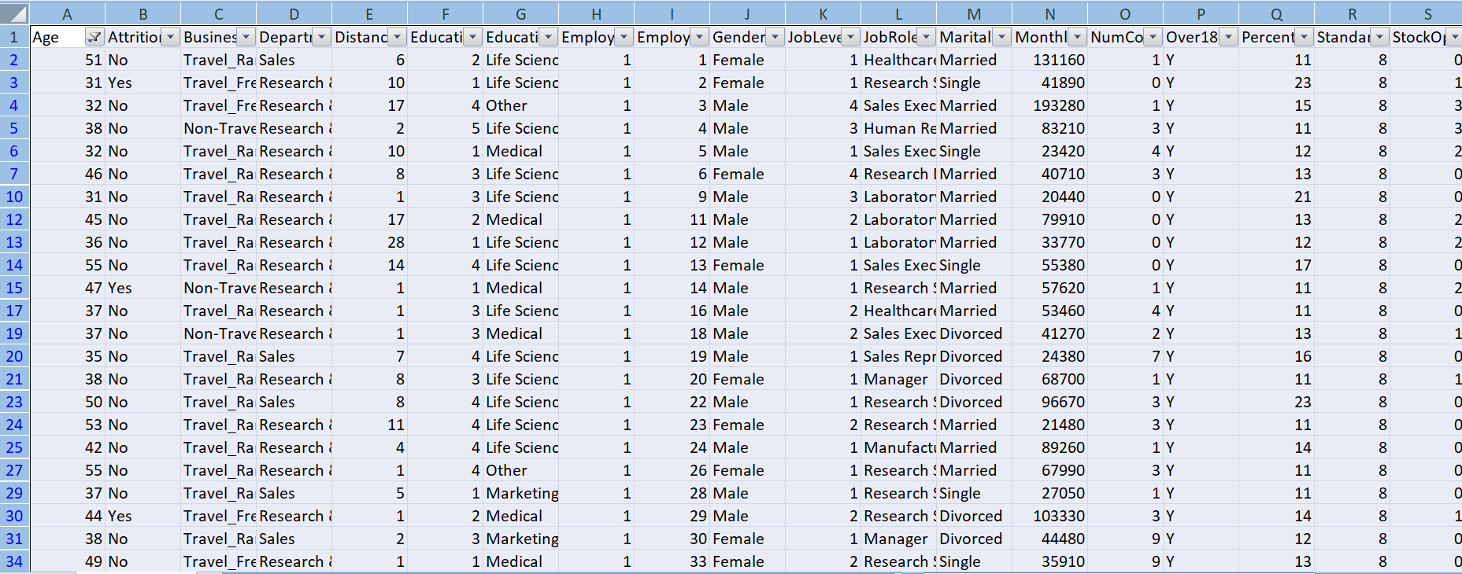
Using Excel, how would you filter the dataset to only show employees aged 30 and above?
Select data set Data Filter Number Filter Greater than or equal Enter 30 and click ‘OK’

Slide 4
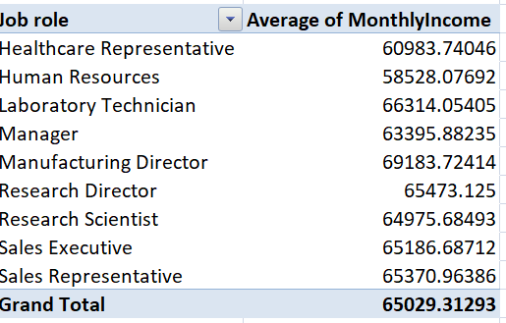
2. Create a pivot table to summarize the average Monthly Income by Job Role.

Slide 5
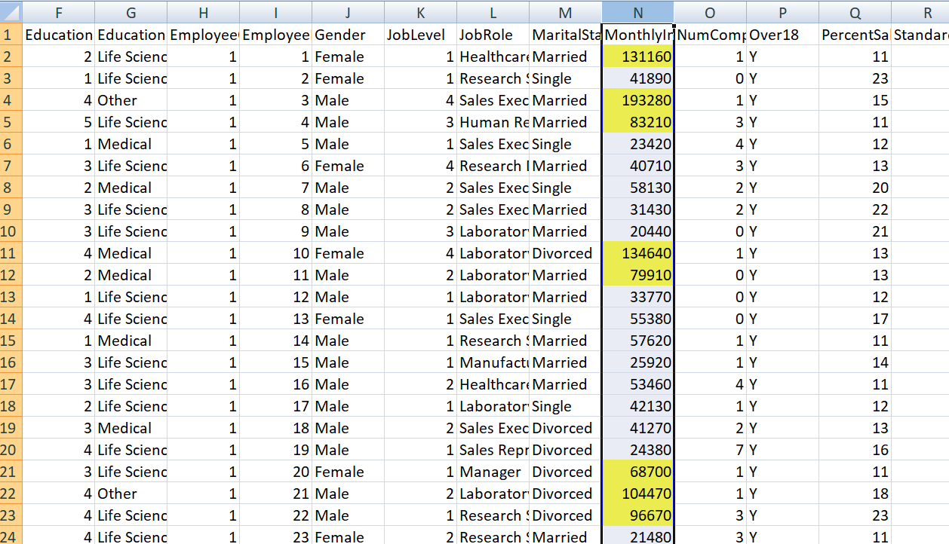
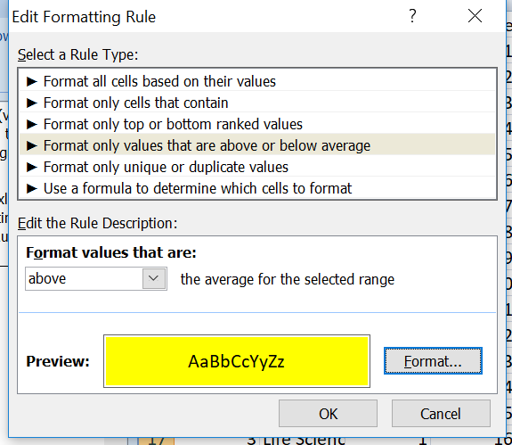
3. Apply conditional formatting to highlight employees with Monthly Income above the company's average income.

Slide 6
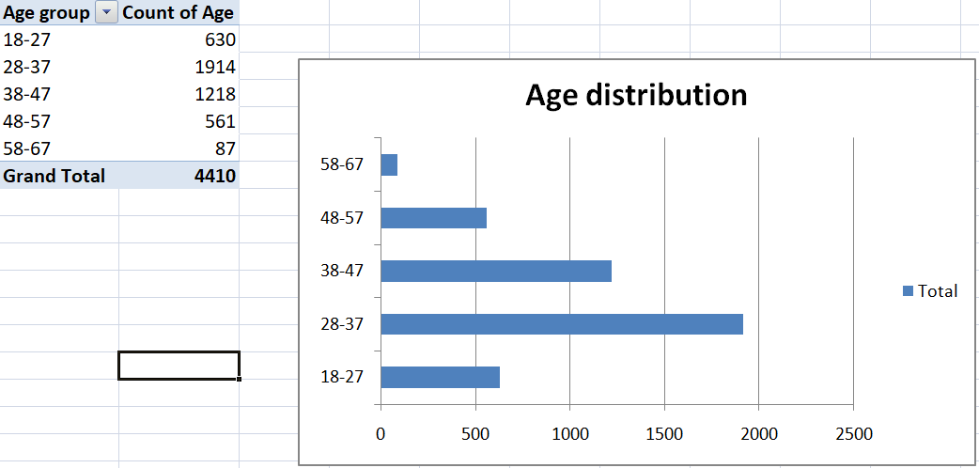
4. Create a bar chart in Excel to visualize the distribution of employee ages.

Slide 7
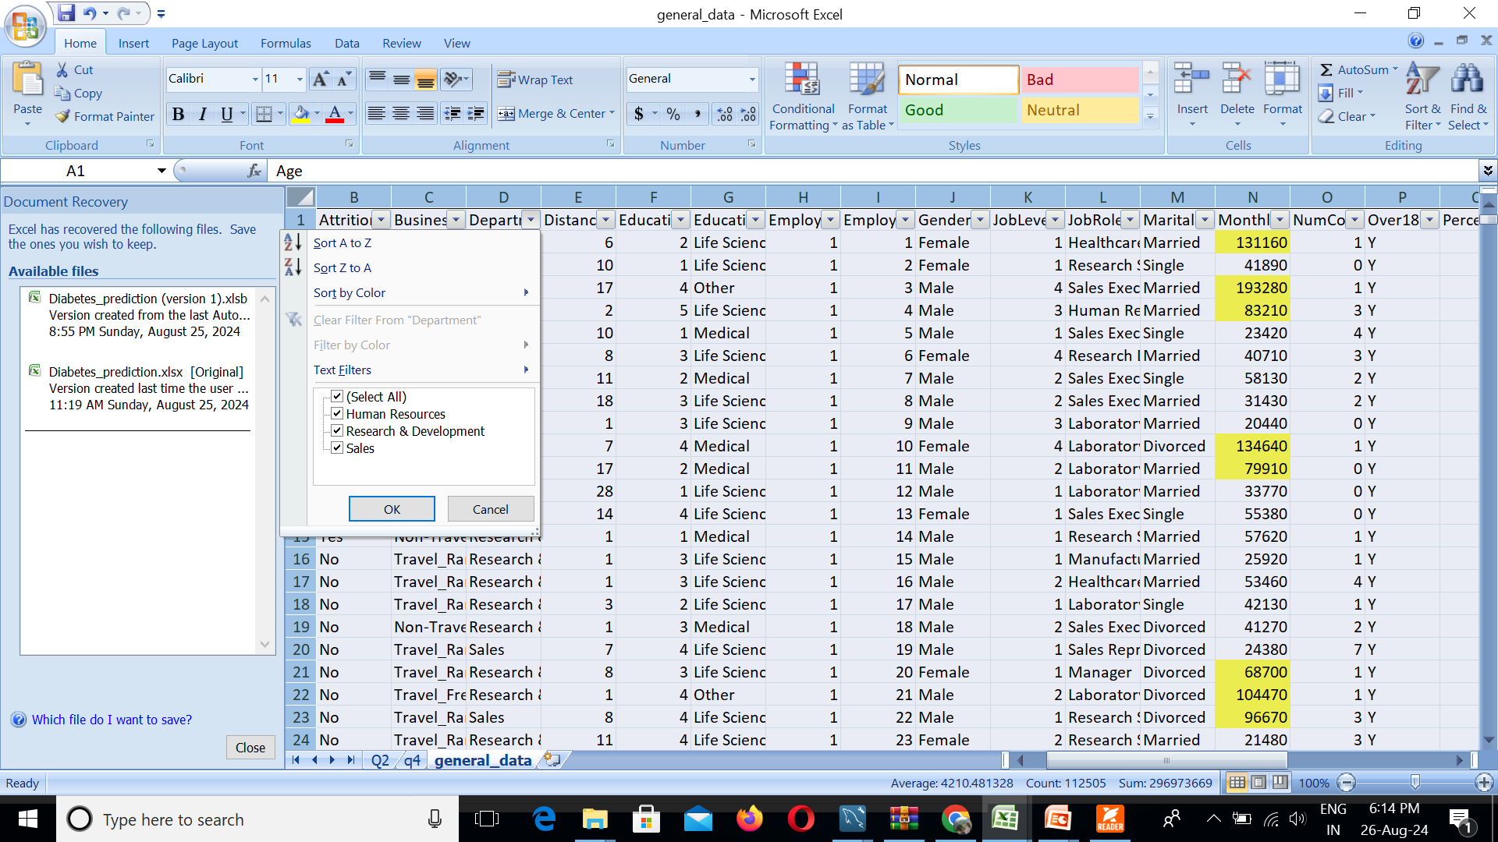
5. Identify and clean any missing or inconsistent data in the "Department" column.
There are no missing or inconsistent data values.

Slide 8
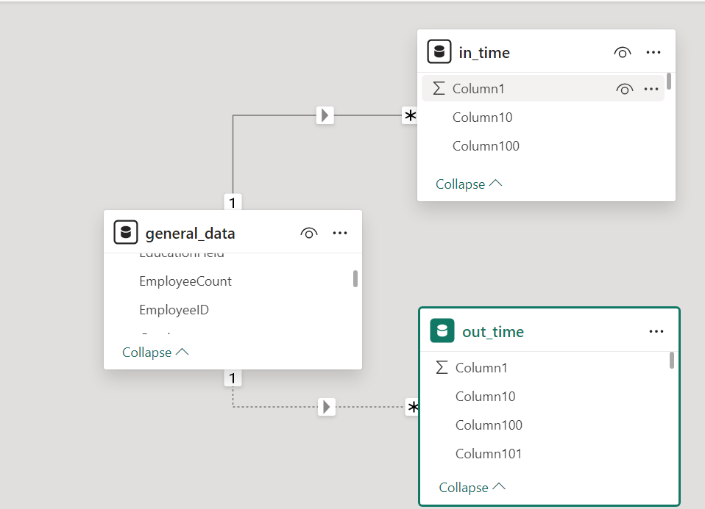
6. In Power BI, establish a relationship between the "EmployeeID" in the employee data and the "EmployeeID" in the time tracking data.

Slide 9
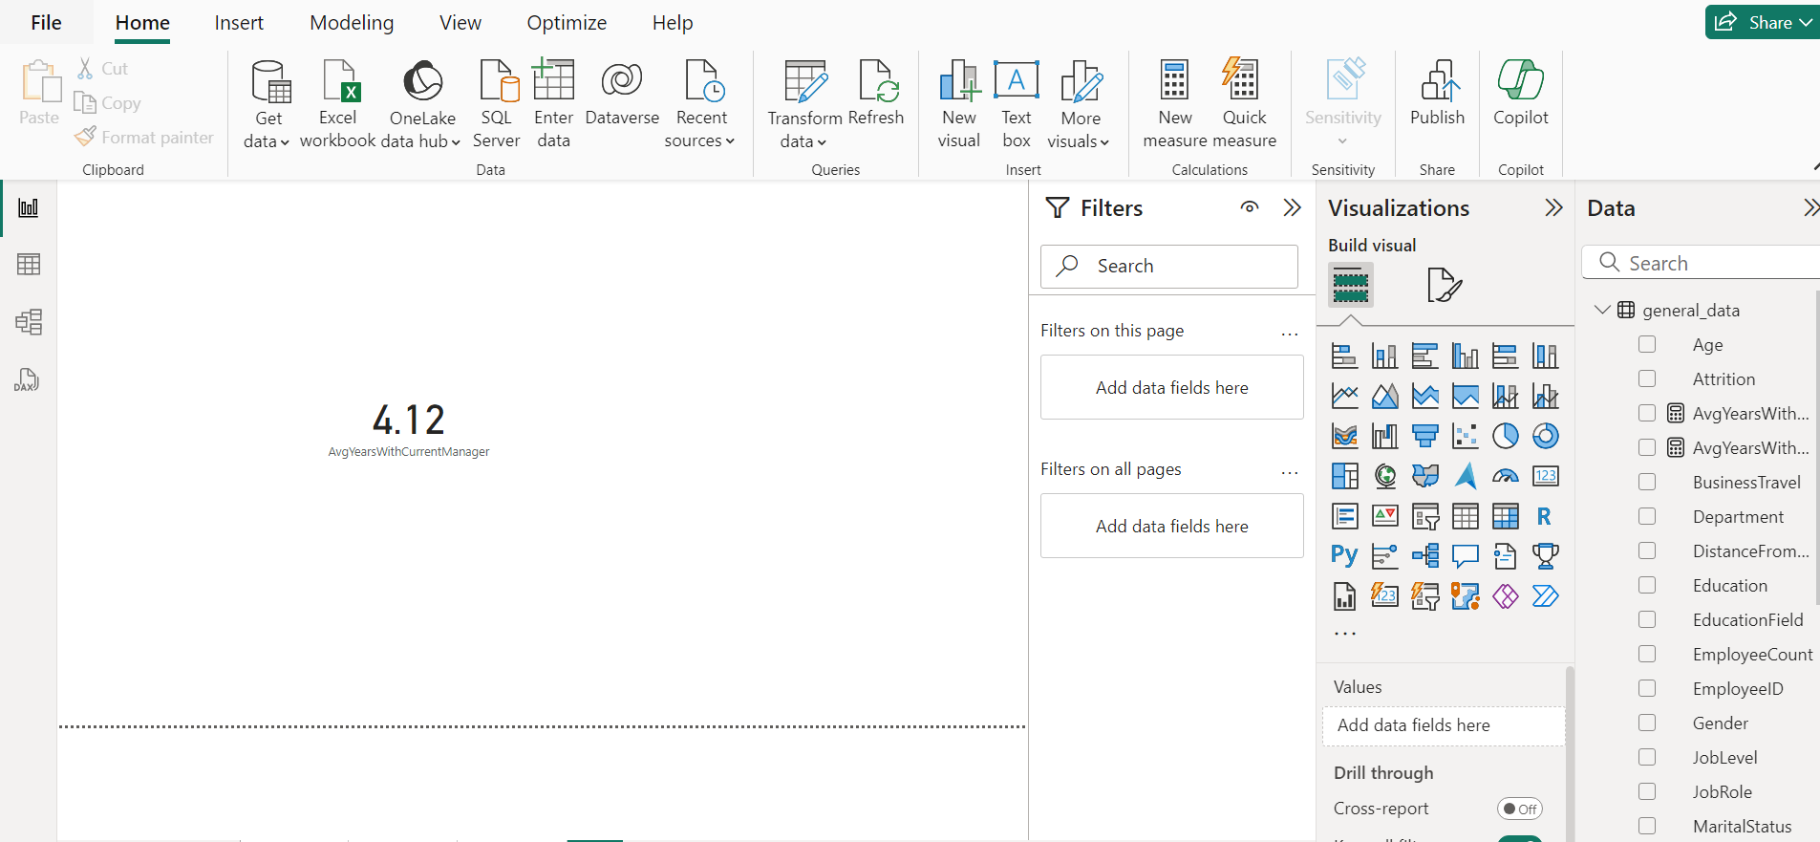
7. Using DAX, create a calculated column that calculates the average years an employee has spent with their current manager.

Slide 10
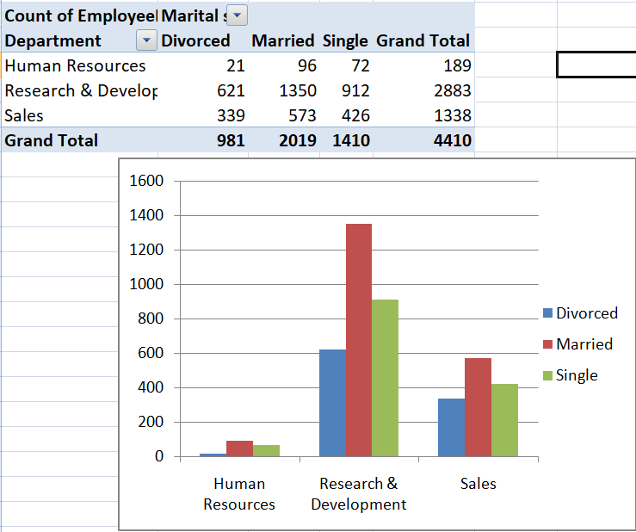
8. Using Excel, create a pivot table that displays the count of employees in each Marital Status category, segmented by Department.

Slide 11
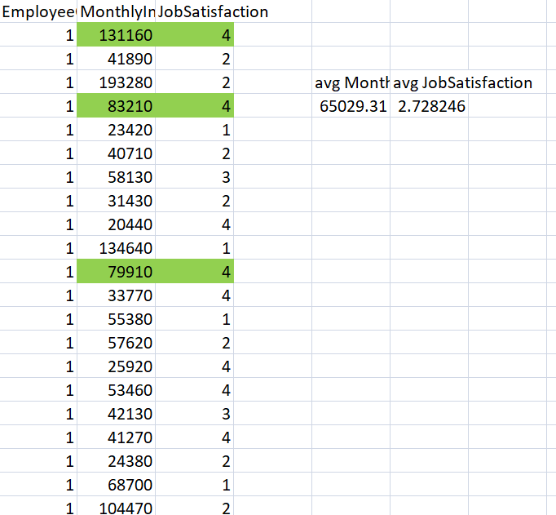
9. Apply conditional formatting to highlight employees with both above-average Monthly Income and above-average Job Satisfaction.

Slide 12
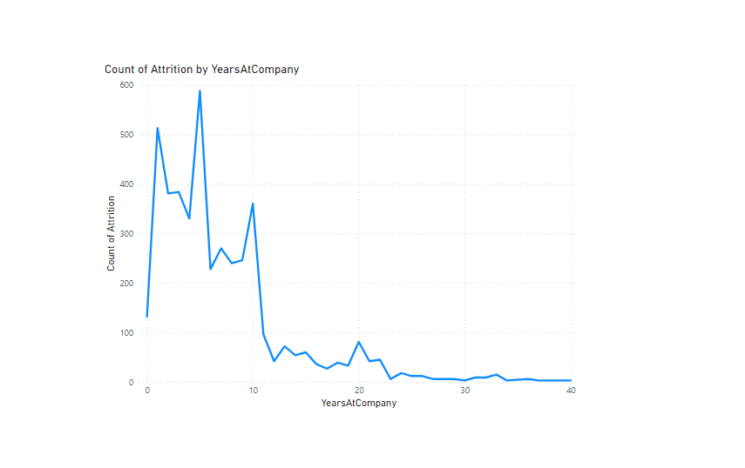
10.In Power BI, create a line chart that visualizes the trend of Employee Attrition over the years.

Slide 13
11. Describe how you would create a star schema for this dataset, explaining the benefits of doing so.
To create a star schema from this dataset, we need to separate it into 'Fact' and 'Dimension' tables with appropriate columns and foreign keys. The general steps are:
Normalize the table into multiple tables, such as 'Employee Attrition Fact Table,' 'Satisfaction Fact Table,' and 'Job Performance Fact Table,' which form the center of the star schema.
Create Dimension tables, including 'Employee Dimension Table,' 'Satisfaction Dimension Table,' ‘Job Performance Dimension Table,' and 'In-Out Time Dimension Table.’
Each dimension table will contain a primary key 'Employee ID,' connected to the foreign key 'Employee ID' in the Fact tables.
This ensures correct data relationships, allowing Power BI to perform accurate analysis and reporting.
Benefits of creating a star schema for this dataset include:
Simplicity and understandability for both technical and non-technical users.
Efficient querying, especially for aggregations and reporting, due to the separation of dimensions and facts.
Scalability to handle large datasets and adaptability to changing reporting requirements.
Minimized data redundancy and efficient security management, with access controls at the dimension and fact table levels.

Slide 14
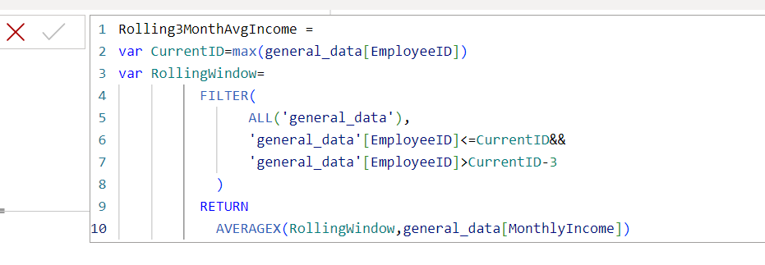
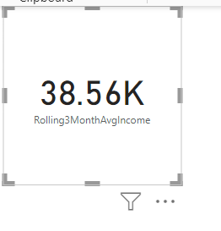
12. Using DAX, calculate the rolling 3-month average of Monthly Income for each employee

Slide 15
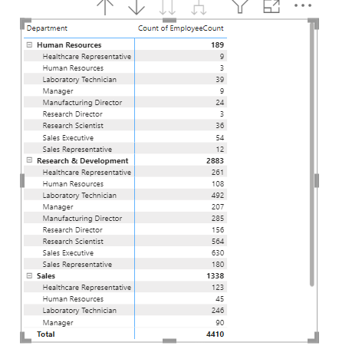
13. Create a hierarchy in Power BI that allows users to drill down from Department to Job Role to further narrow their analysis.

Slide 16
14. How can you set up parameterized queries in Power BI to allow users to filter data based 2 of 2 on the Distance from Home column?
To set up parameterized queries in Power BI to allow users to filter data based on the "Distance from Home" column:
Open Power Query Editor.
Go to "Manage Parameters" > "New Parameter.“
Name the parameter (e.g., `Distance Filter`), set its data type, and define a default value.
In your query, apply a filter on the "Distance from Home" column using the parameter (e.g., `Distance from Home <= Distance Filter`).
Load the query back to Power BI.
Create a slicer or input box in your report, binding it to the parameter, allowing users to dynamically adjust the filter value.

Slide 17
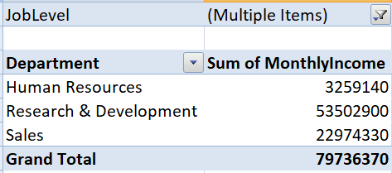
15. In Excel, calculate the total Monthly Income for each Department, considering only the employees with a Job Level greater than or equal to 3.

Slide 18
16. Explain how to perform a What-If analysis in Excel to understand the impact of a 10% increase in Percent Salary Hike on Monthly Income.
To perform a What-If analysis in Excel to understand the impact of a 10% increase in Percent Salary Hike on Monthly Income:
Prepare Your Data: - List your current `Monthly Income` and `Percent Salary Hike` in a table. - Ensure you have columns for `New Percent Salary Hike` and `New Monthly Income`.
Set Up the Analysis: - In the `New Percent Salary Hike` column, calculate a 10% increase by multiplying the `Percent Salary Hike` by 1.10 (e.g., `=B2*1.10` where B2 is the `Percent Salary Hike` cell).
Calculate the New Monthly Income: - In the `New Monthly Income` column, update the `Monthly Income` based on the increased `Percent Salary Hike`. Assuming the salary hike impacts the monthly income directly, use a formula like `=A2 * (1 + C2)` where A2 is `Monthly Income` and C2 is the `New Percent Salary Hike`.
Review Results: - The `New Monthly Income` column will show the impact of the 10% increase in `Percent Salary Hike`.
By following these steps, you can effectively analyze the impact of a salary hike on monthly income using Excel’s What-If analysis features.

Slide 19
17. Verify if the data adheres to a predefined schema. What actions would you take if you find inconsistencies?
If data does not adhere to a predefined schema, I would take the following actions:
Identify Inconsistencies: Analyze the data to pinpoint where it deviates from the schema, checking for missing, incorrect, or improperly formatted fields. In this data, there is a need to reorder EmployeeID column, changing data type of 'TotalWorkingHours' column, flling NA values and blank values from general_data, employee_survey_data, manager_survey_data.
Document Findings: Document specific inconsistencies and their impact on downstream processes or analyses.
Communicate: Notify stakeholders or data owners about the discrepancies, seeking clarification or additional context.
Rectify Data: Depending on the severity, either clean the data manually or programmatically align it with the schema.
Implement Check: Establish checks or validation rules to prevent future inconsistencies and ensure ongoing data integrity.

Slide 20
THANK YOU…

